Slide 1

DLL Search Order, Sideloading & Proxing
Kathan Patel

Slide 2
Agenda
DLL Search Order (T1574.001)
DLL Sideloading (T1574.002)
DLL Proxying(T1574.002 & T1218)
Demo

Slide 3
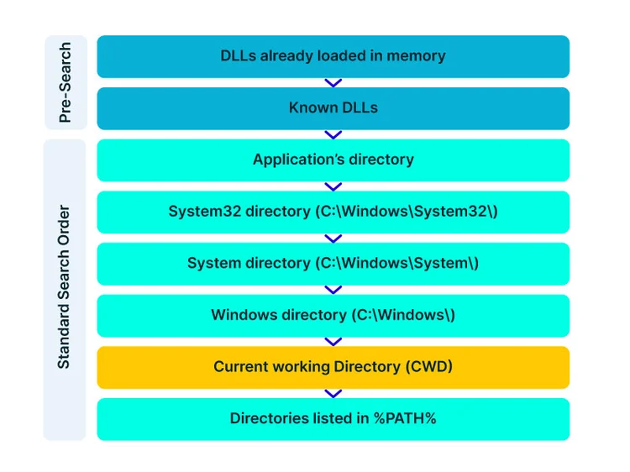
DLL Search Order Hijacking
DLL search order hijacking is a technique used by adversaries to execute their own malicious payloads by hijacking the search order used to load DLLs.
Windows systems use a common method to look for required DLLs to load into a program.
Hijacking DLL loads may be for the purpose of establishing persistence as well as elevating privileges and/or evading restrictions on file execution.

Slide 4
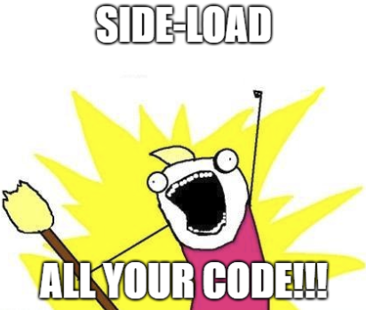
DLL Sideloading
Side-loading takes advantage of the DLL search order used by the loader by positioning both the victim application and malicious payload(s) alongside each other.
Adversaries likely use side-loading as a means of masking actions they perform under a legitimate, trusted, and potentially elevated system or software process.

Slide 5
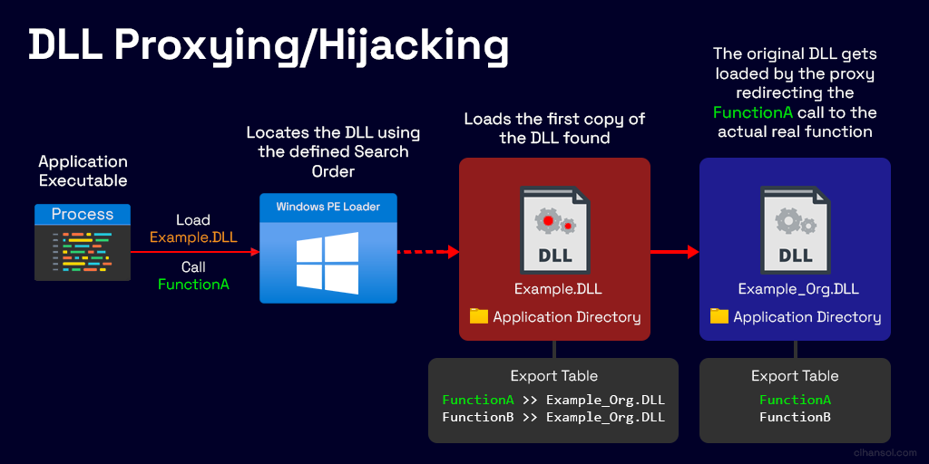
DLL Proxying
DLL proxying is a technique used by adversaries to bypass process and/or signature-based defenses by proxying execution of malicious content with signed, or otherwise trusted, binaries.
Binaries used in this technique are often Microsoft-signed files, indicating that they have been either downloaded from Microsoft or are already native in the operating system

Slide 6
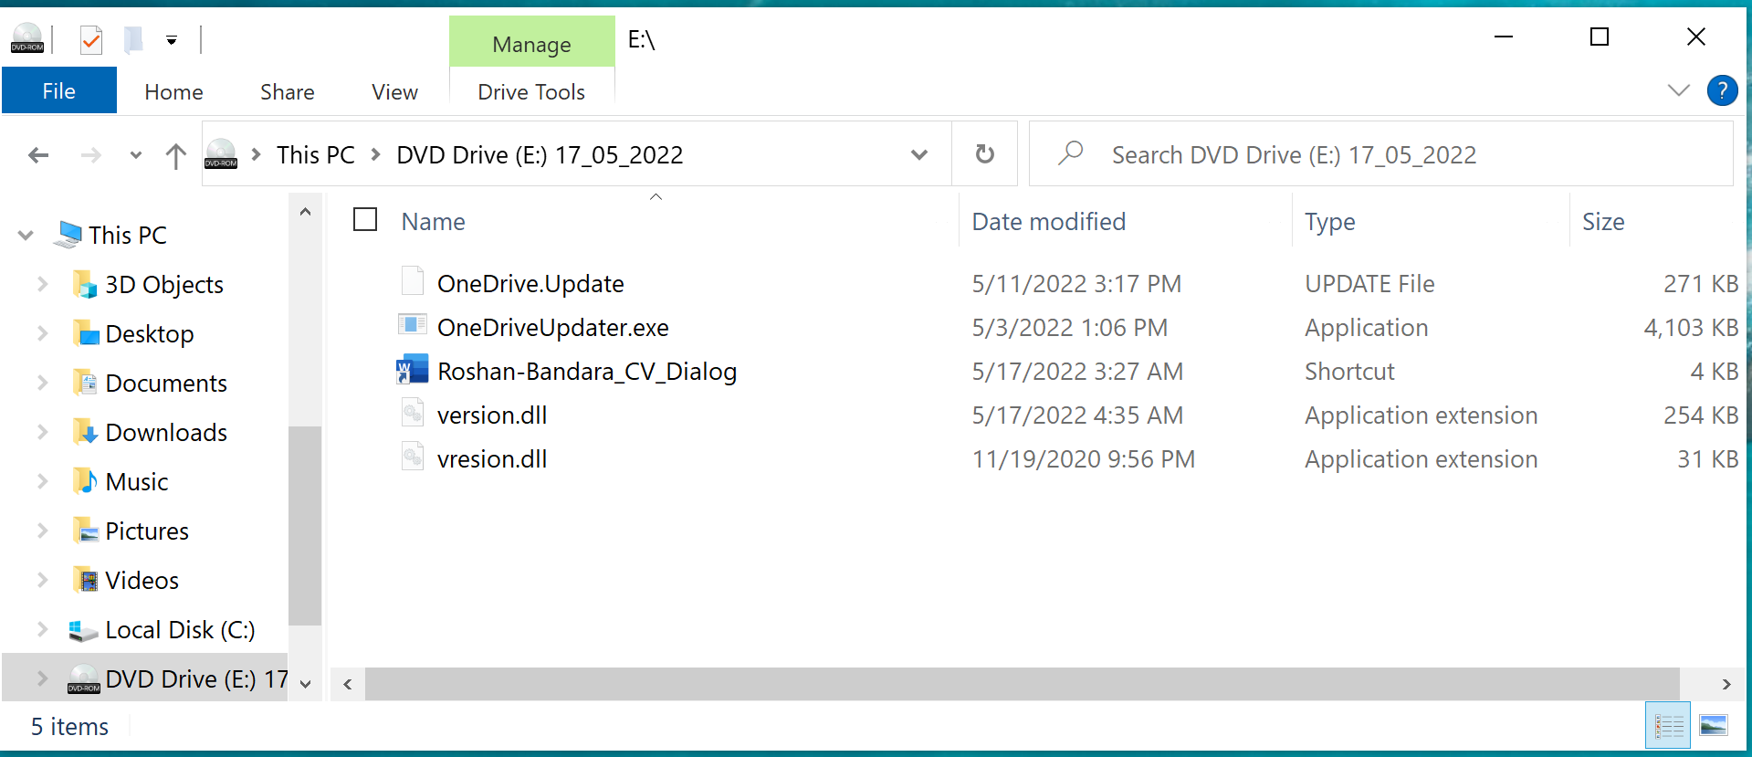
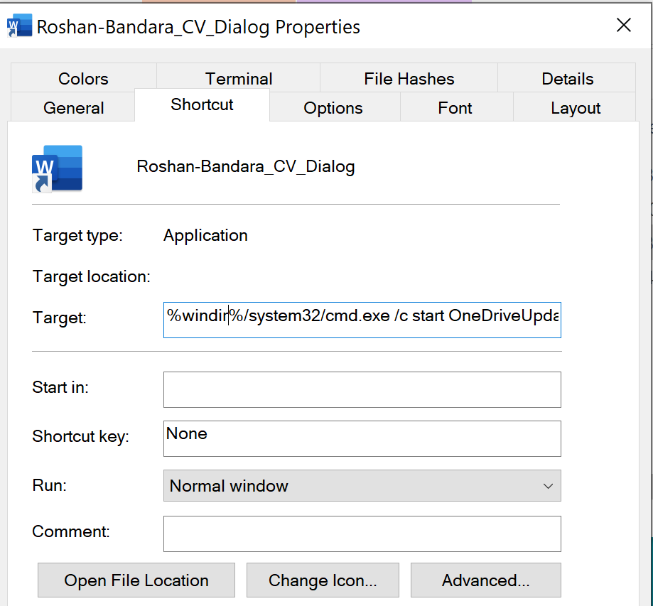
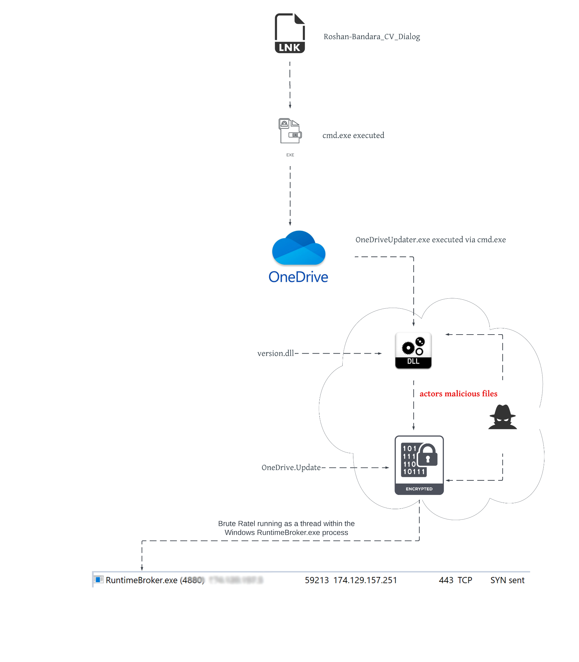
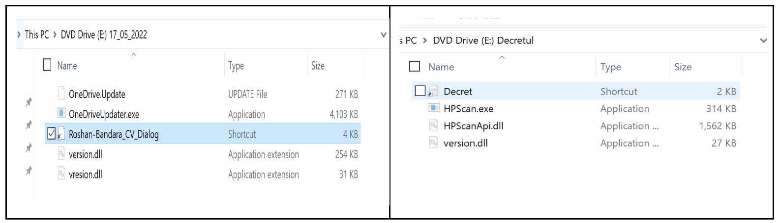
Brute Ratel C4 Red Teaming Tool Being Abused by Malicious Actors (paloaltonetworks.com)

Slide 7
References:
Hijack Execution Flow: DLL Search Order Hijacking, Sub-technique T1574.001 - Enterprise | MITRE ATT&CK®
Hijack Execution Flow: DLL Side-Loading, Sub-technique T1574.002 - Enterprise | MITRE ATT&CK®
Dynamic-link library search order - Win32 apps | Microsoft Learn
Brute Ratel C4 Red Teaming Tool Being Abused by Malicious Actors (paloaltonetworks.com)
DLL Search Order Hijacking - Red Canary Threat Detection Report
Reported Unsafe Site: Navigation Blocked (hacktricks.xyz)
CVE-2022-32223 Discovery: DLL Hijacking via npm CLI (aquasec.com)
Guide to DLL Sideloading | Crypt0ace
Windows DLL Proxying/Hijacking – Dev Blog (cihansol.com)

Slide 8
Thank you
Email: patelkathan@proton.me
LinkedIn: https://www.linkedin.com/in/kathanp19/
X: https://x.com/KathanP19
Github: https://github.com/KathanP19

